Slide 1
Chapter 12
Introduction to ASP.NET
Programming the World Wide Web
Fourth edition
By Robert W. Sebesta

Slide 2
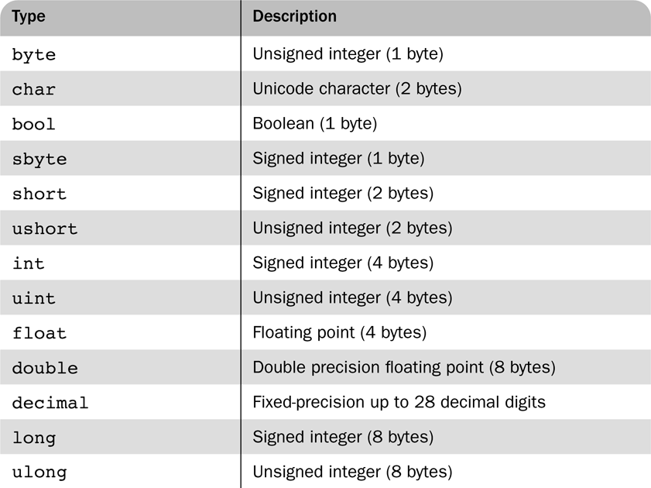
Table 12.1 The primitive types of C#

Slide 3
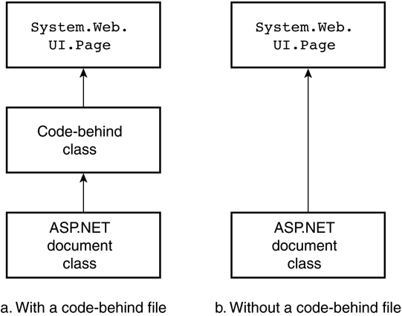
Figure 12.1 Inheritance diagrams for ASP.NET documents with and without code-behind files

Slide 4
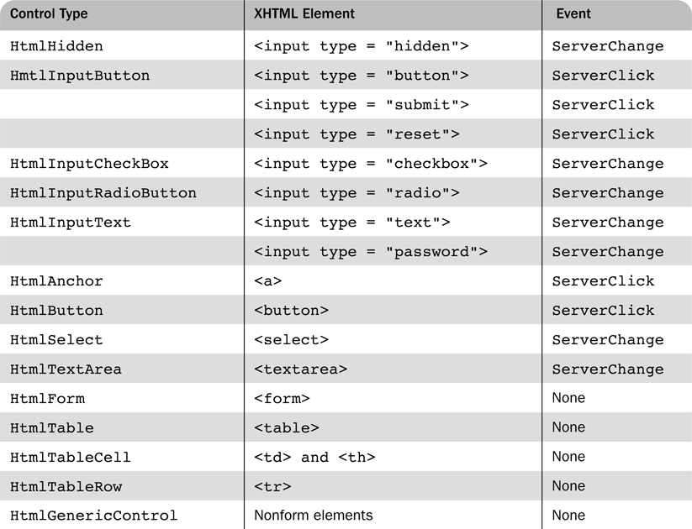
Table 12.2 HTML control types, corresponding XHTML elements, and their events

Slide 5
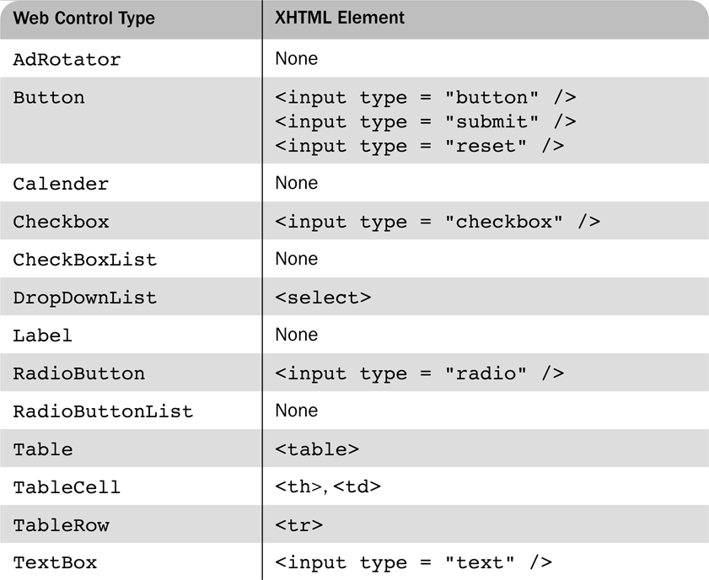
Table 12.3 Commonly used Web controls and related XHTML elements

Slide 6
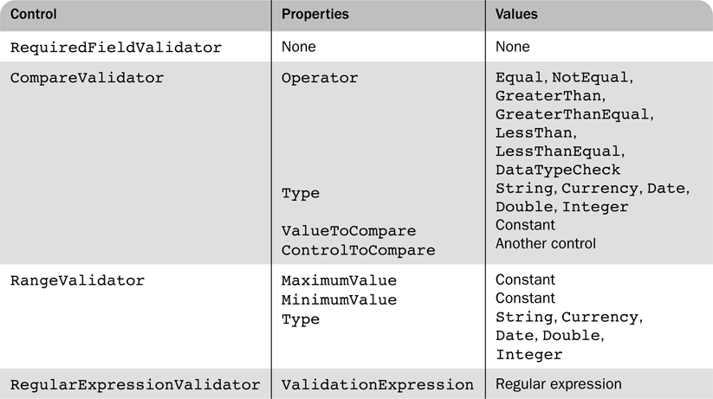
Table 12.4 Validation controls and their properties

Slide 7
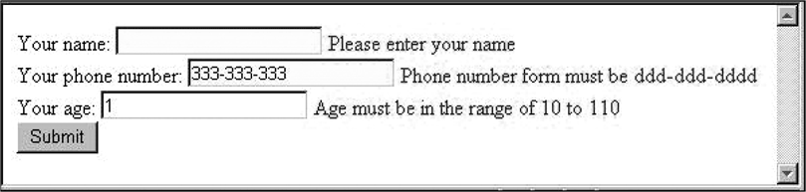
Figure 12.2 Display of ex4.aspx after some text boxes have been filled

Slide 8
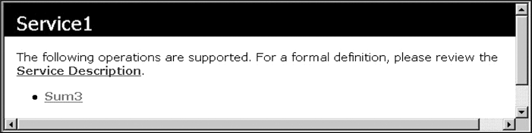
Figure 12.3 An IE browser display of the Service1

Slide 9
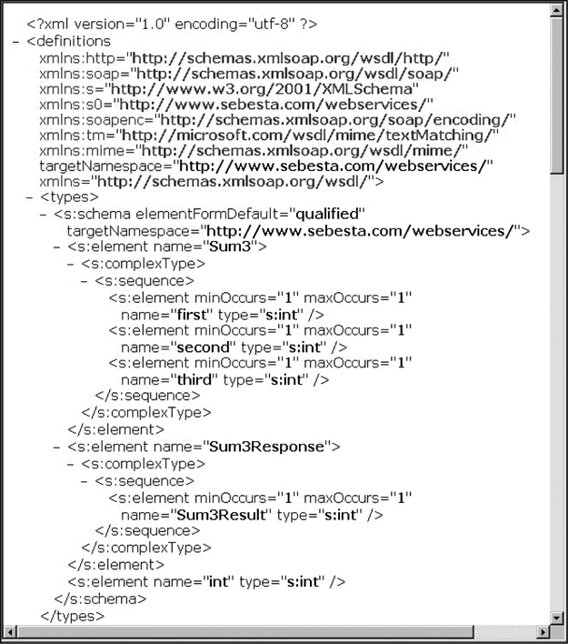
Figure 12.4 The first part of a service description

Slide 10
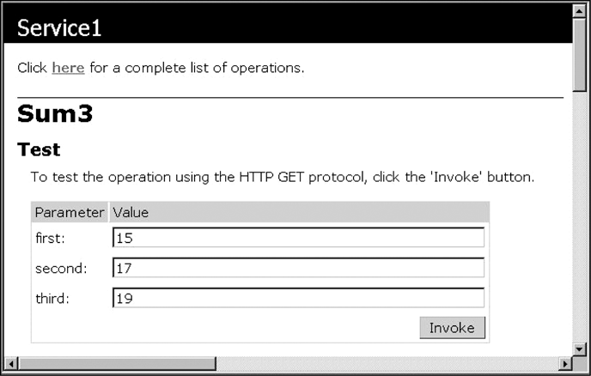
Figure 12.5 The test display for the Sum3 service

Slide 11
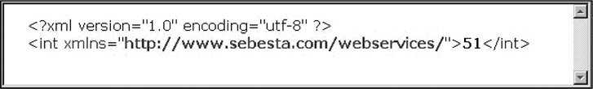
Figure 12.6 The result of invoking the Sum3 tester

